Slide 1
Project2ftw
Benjamin Ruiz, Brady Dyson, Brian McKenzie, Tiffany Garner, TonyTam Dinh
Notes:
Brian will speak

Slide 2
Table of Contents
Tech Stack
Queries
Summary
Questions/Demo
Notes:
Brian will speak

Slide 3
Tech Stack
Apache Spark
Spark SQL
YARN
HDFS
SBT
Scala 2.11.12
Git + GitHub
benjaminruiz99/RevatureProject2ftw
Zeppelin
Notes:
Brian will speak

Slide 4
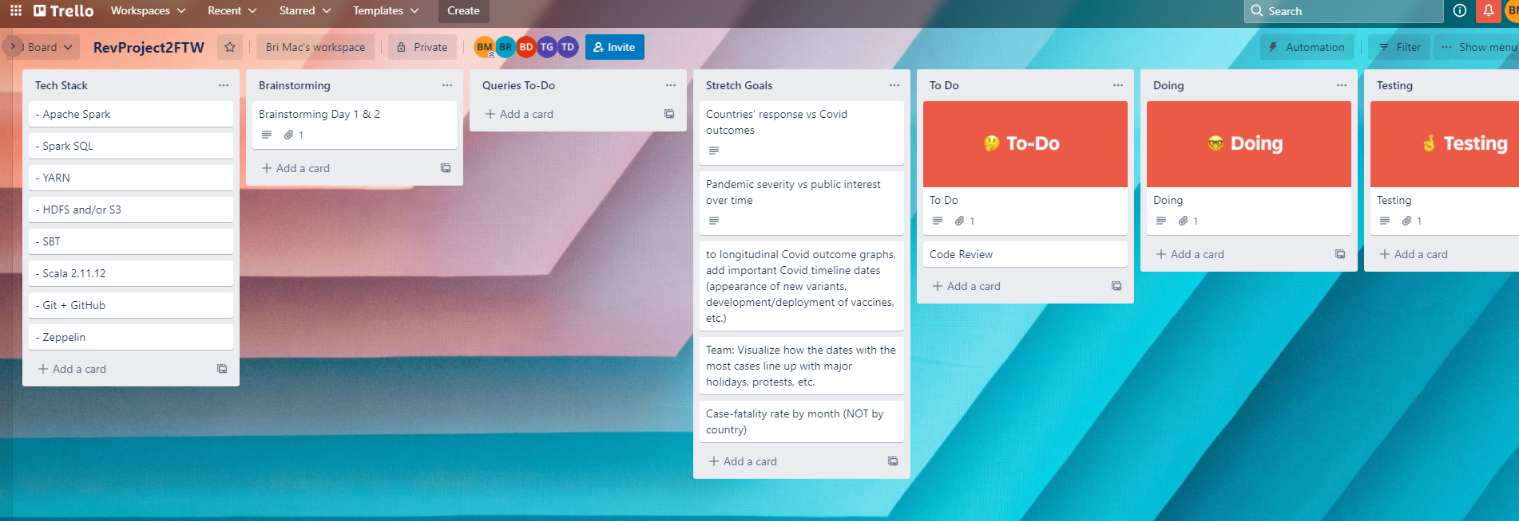

Kanban Board
Notes:
Brian will speak

Slide 5
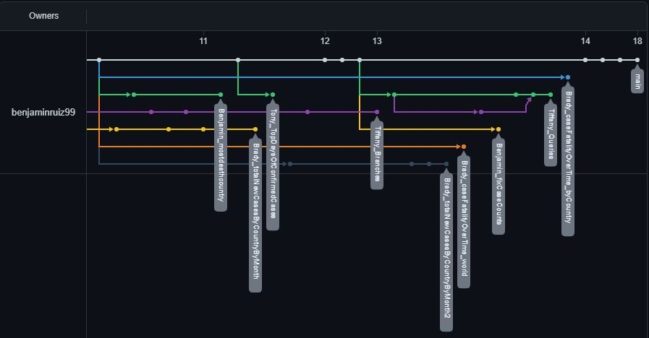
Github Commits/Branches
Notes:
Brian will speak

Slide 6
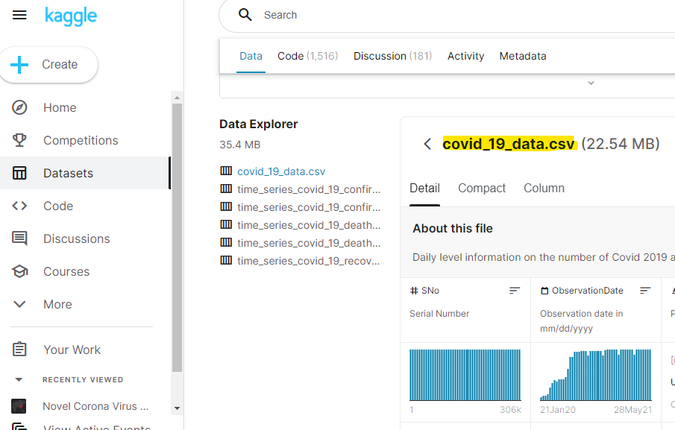
Notes:
Brian will speak

Slide 7

Cumulative vs. Non-Cumulative Data
Cumulative:
Up to given date
Non-cumulative:
Within given period
Notes:
Brian will speak
The data we used is cumulative, but we had to change it to non-cumulative for some of our queries.

Slide 8
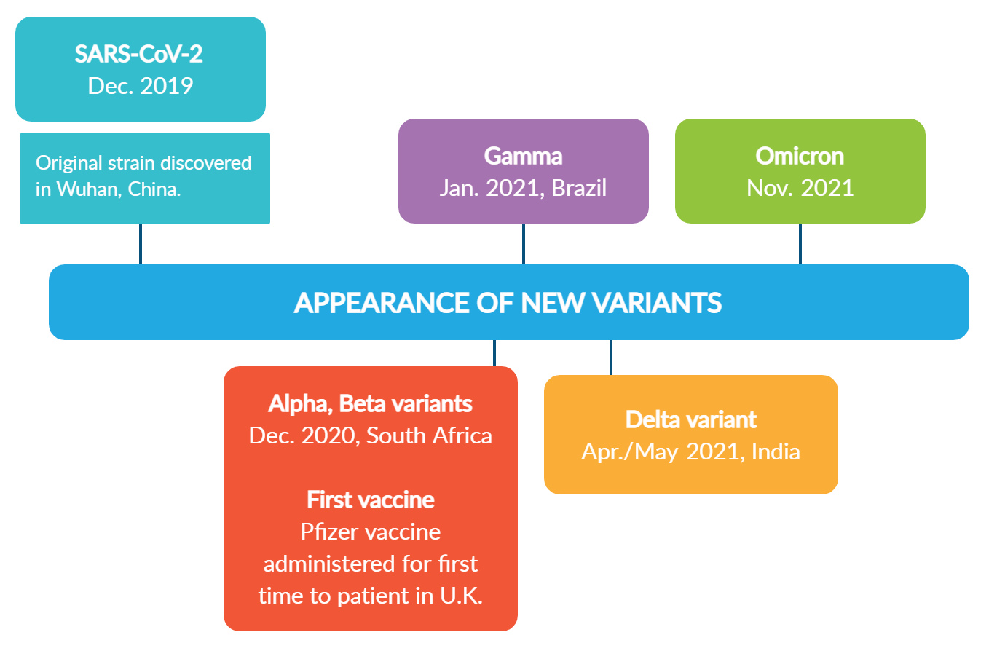

Slide 9
WHO label | Date of designation | Earliest documented samples
SARS-CoV-2 | 12/1/19 | China
Alpha | 12/18/20 | United Kingdom | Sep-2020
Beta | 12/18/20 | South Africa | May-2020
Gamma | 01/11/21 | Brazil | Nov-2020
Delta | VOI: 4-Apr-2021 VOC: 11-May-2021 | India | Oct-2020
Omicron* | VUM: 24-Nov-2021 VOC: 26-Nov-2021 | Multiple countries | Nov-2021

Slide 10
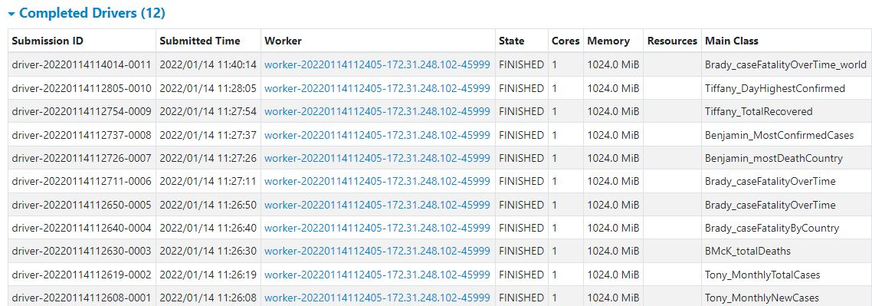
Spark Submit Pic
Notes:
Brian will speak

Slide 11
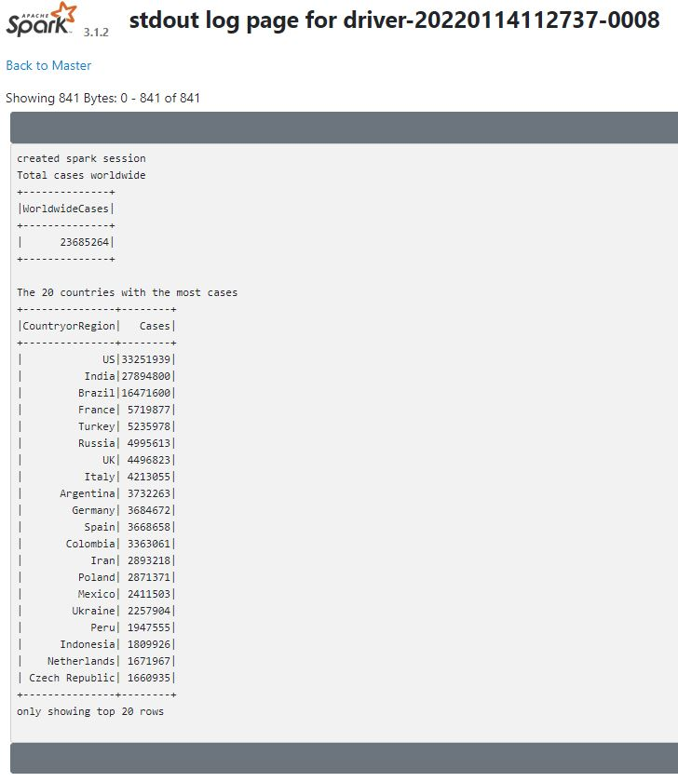
What are the most confirmed cases? SparkSubmit
Notes:
Ben will speak

Slide 12
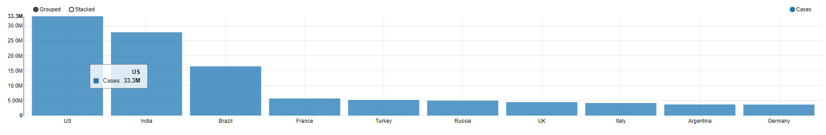
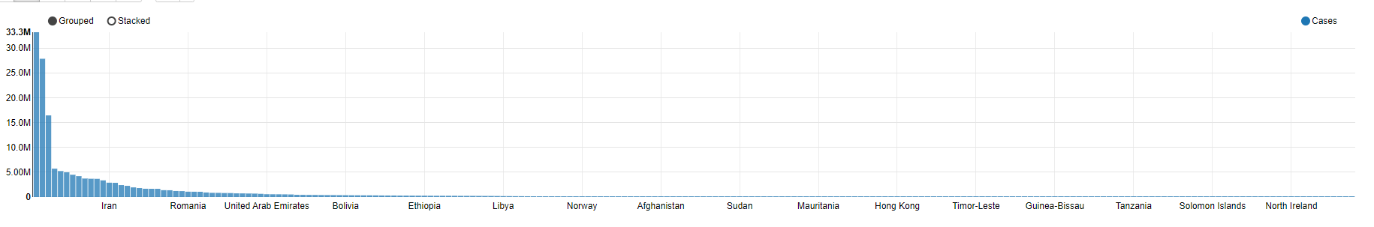
Confirmed Cases Zeppelin Graph
Notes:
Ben will speak

Slide 13
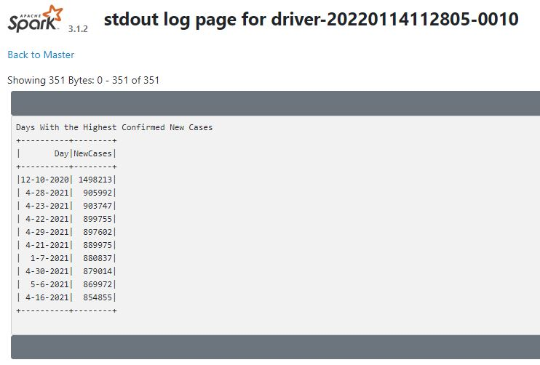
What date had the highest confirmed cases? SparkSubmit
Notes:
Tiffany will speak

Slide 14
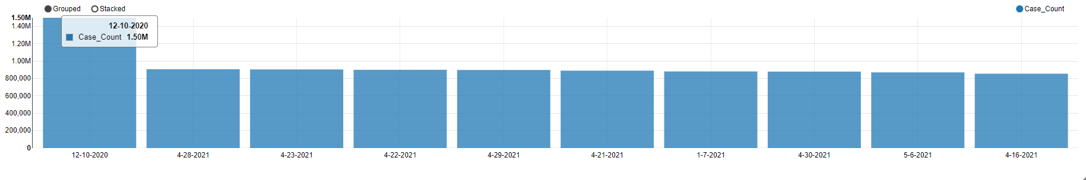
What date had the highest confirmed cases? SparkSubmit
Notes:
Tiffany

Slide 15
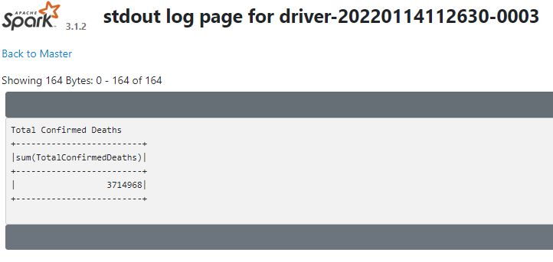
What are the total confirmed deaths? SparkSubmit
3,714,968
Notes:
Brian will speak

Slide 16
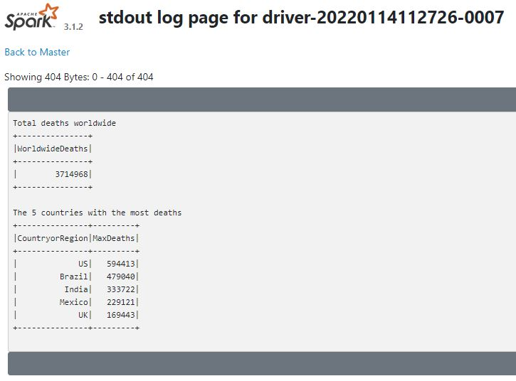
What are the most deaths for each country? SparkSubmit
Notes:
Ben will speak : also look into the covid history of these countries and why they had such high death counts

Slide 17
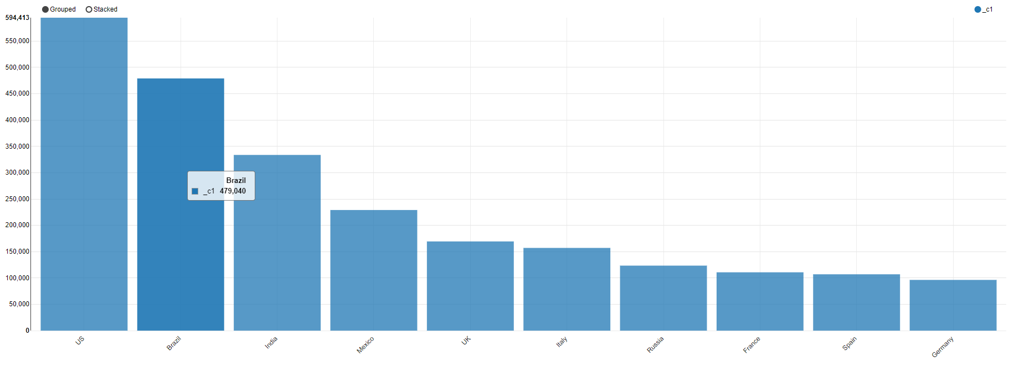
What are the most deaths for each country? SparkSubmit
Notes:
Ben will speak

Slide 18
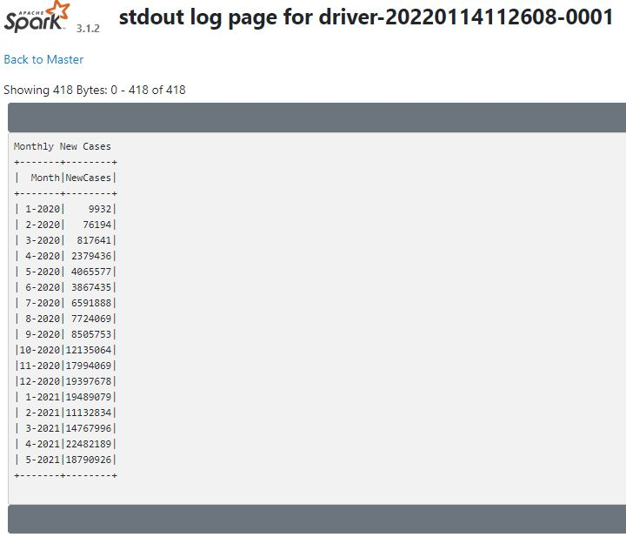
Monthly New Cases Worldwide SparkSubmit
Notes:
Tony will speak

Slide 19
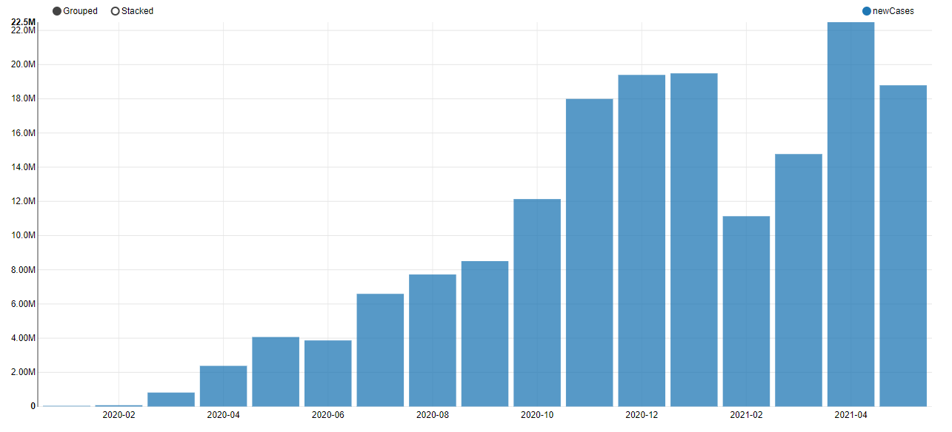
How many new cases were there each month?
Notes:
Tony

Slide 20
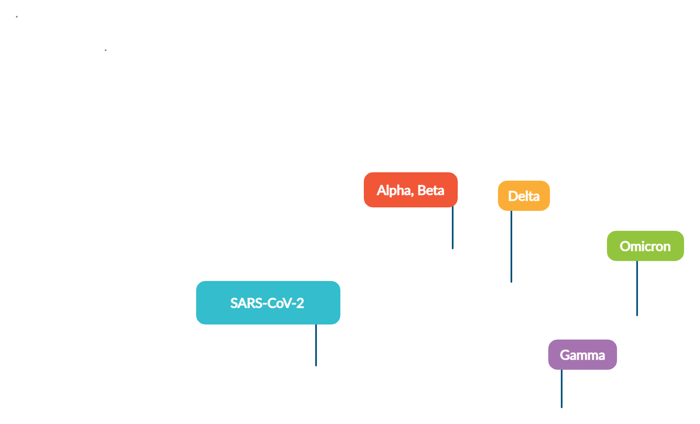
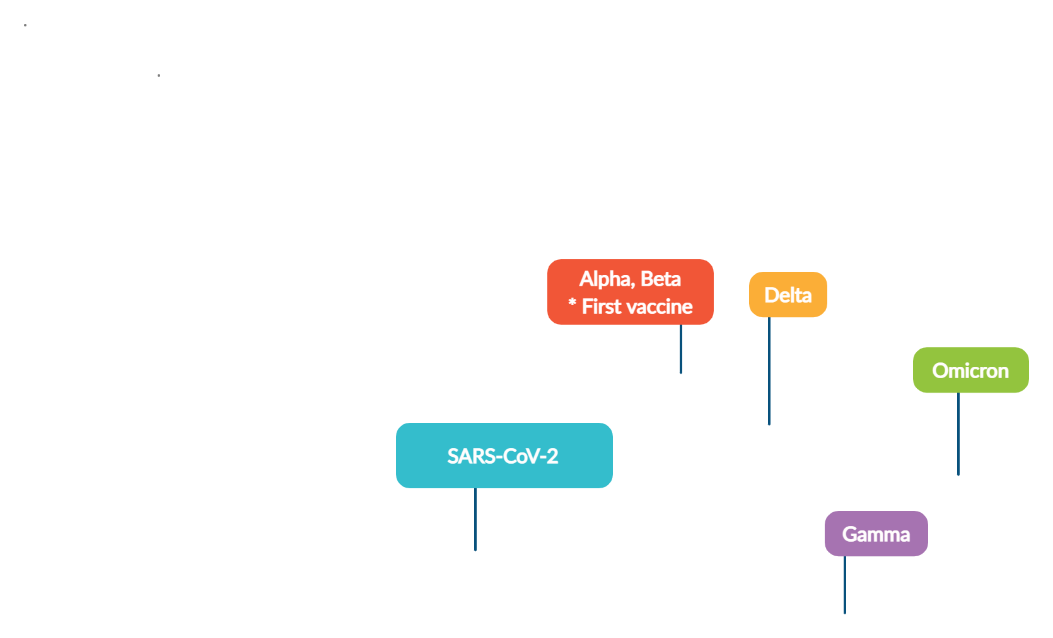
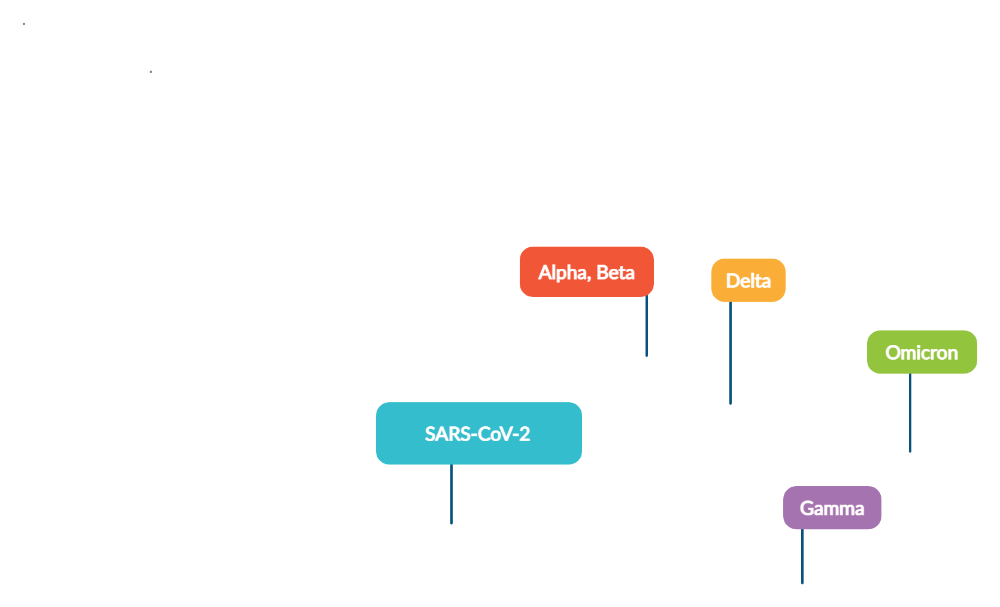
How many new cases were there each month?
Notes:
Tony

Slide 21
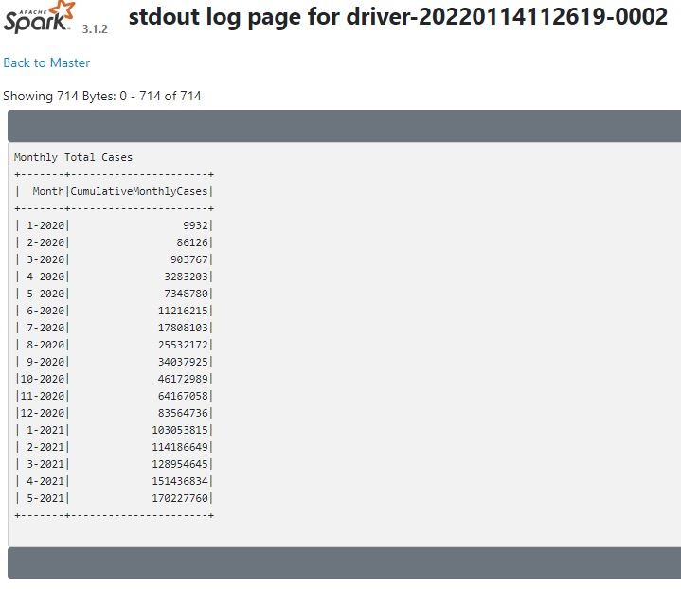
Monthly Total Cases Worldwide SparkSubmit
Notes:
Tony will speak

Slide 22
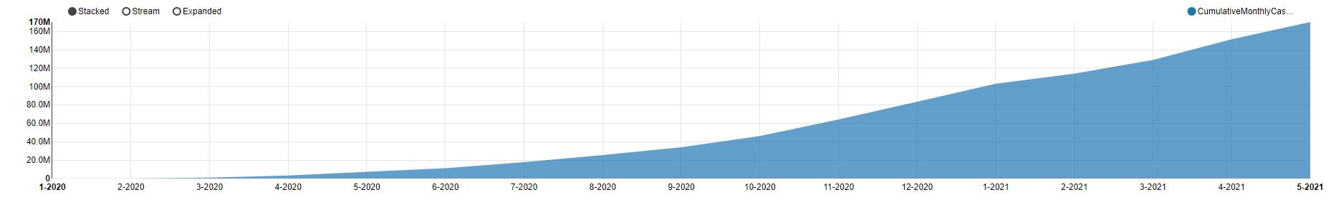
World TOTAL Cases by Month
Notes:
Tony

Slide 23
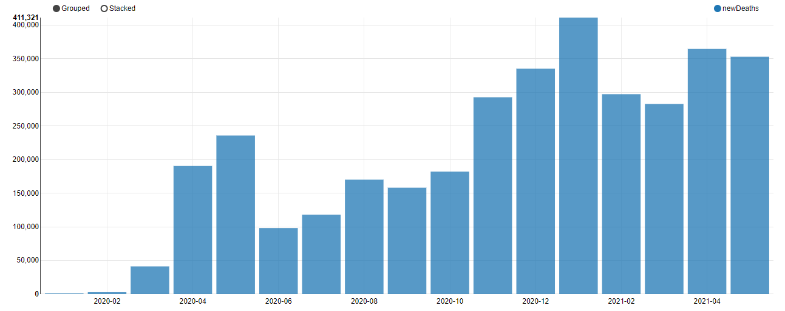
How many new deaths were there each month worldwide?
Notes:
Tony will speak

Slide 24
How many new deaths were there each month worldwide?
Notes:
Tony will speak

Slide 25
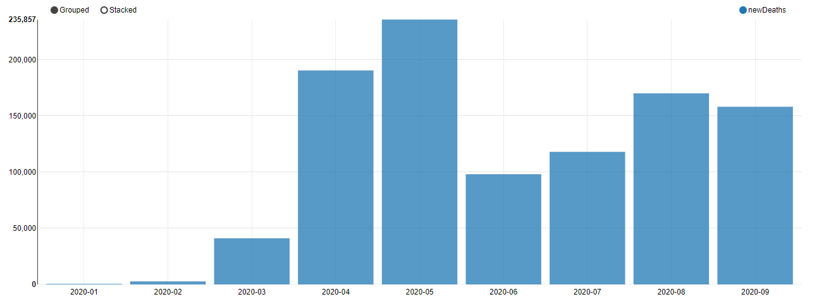
How many new deaths were there each month worldwide?
Jan. 2020 - Sept. 2020
Notes:
Ben will speak

Slide 26
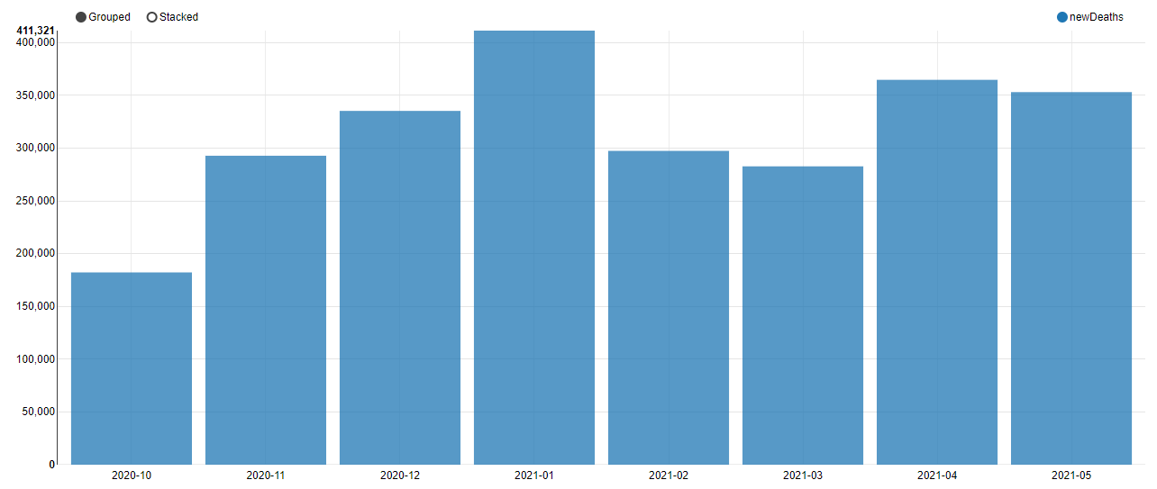
How many new deaths were there each month worldwide?
Oct. 2020 - May. 2021
Notes:
Tiffany

Slide 27
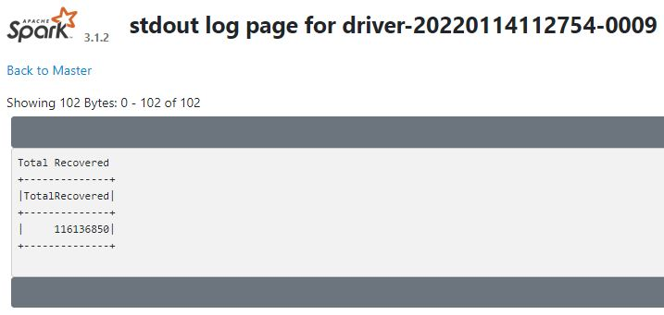
What were the total amount of recovered cases? SparkSubmit
116,136,850
Notes:
Tiffany

Slide 28
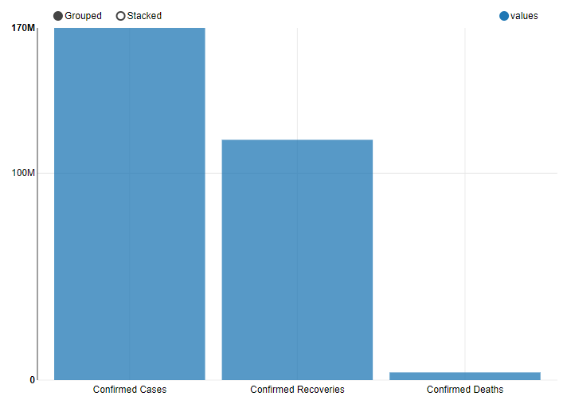
Confirmed Cases | Confirmed Recoveries | Confirmed Deaths
170,227,760 | 116,136,850 | 3,714,968
Notes:
Tiffany

Slide 29
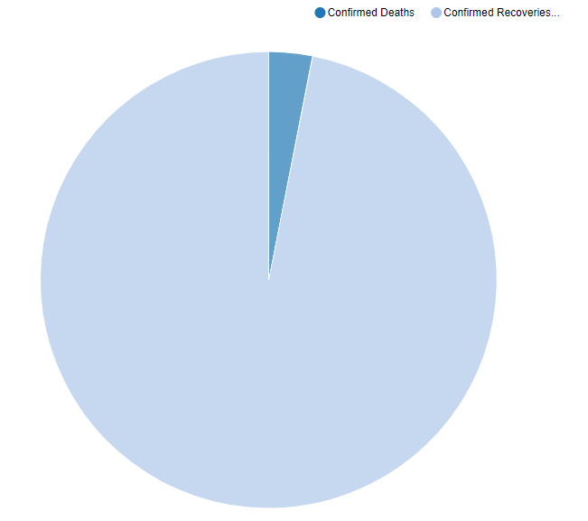
Caution. Recovery data incomplete due to:
Ongoing cases
Incomplete follow up
Notes:
Tiffany

Slide 30
Case-Fatality Rate
Notes:
Brady is speaking

Slide 31
Case-Fatality Rate
Case-fatality rate
Mortality rate
Other metrics…
Notes:
Brady is speaking

Slide 32
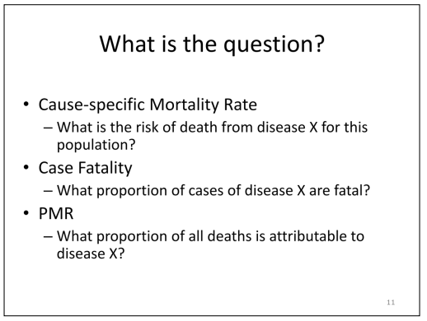
Notes:
Brady is speaking

Slide 33
Case-Fatality Rate
Case-fatality rate
Mortality rate
Other metrics…
Notes:
Brady is speaking

Slide 34
Case-Fatality Rate
Case-fatality rate
Mortality rate
Other metrics…
Notes:
Brady is speaking

Slide 35
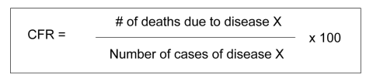
Case-Fatality Rate
Monthly CFR: takes into account only the data from a certain month
Cumulative CFR: takes into account all data up to a certain date
Notes:
Brady is speaking

Slide 36
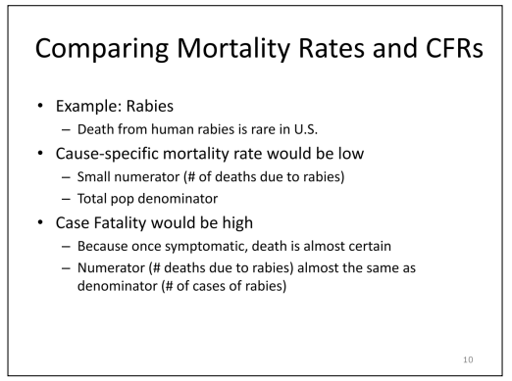

Slide 37
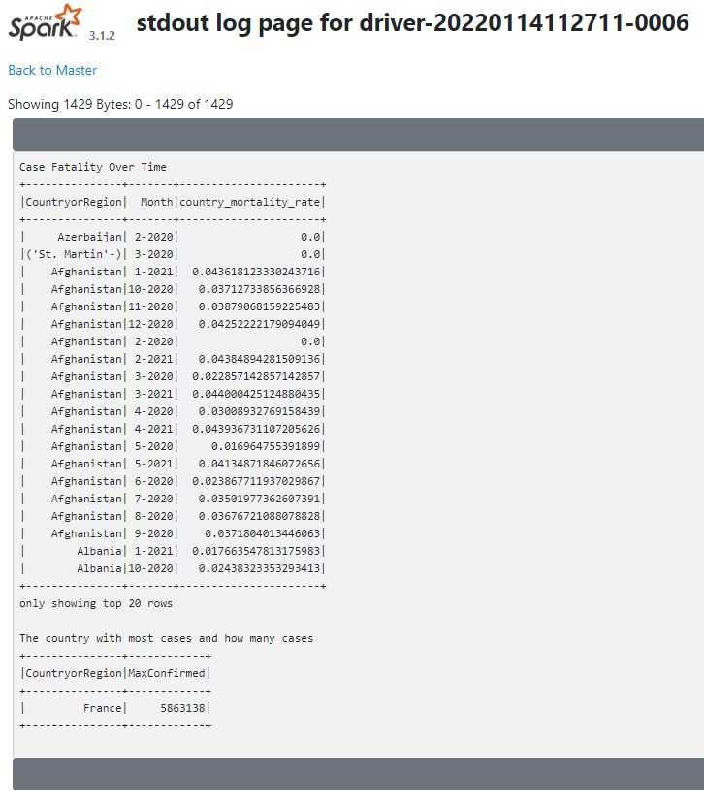
Case Fatality OverTime SparkSubmit
Notes:
Tiffany will speak

Slide 38
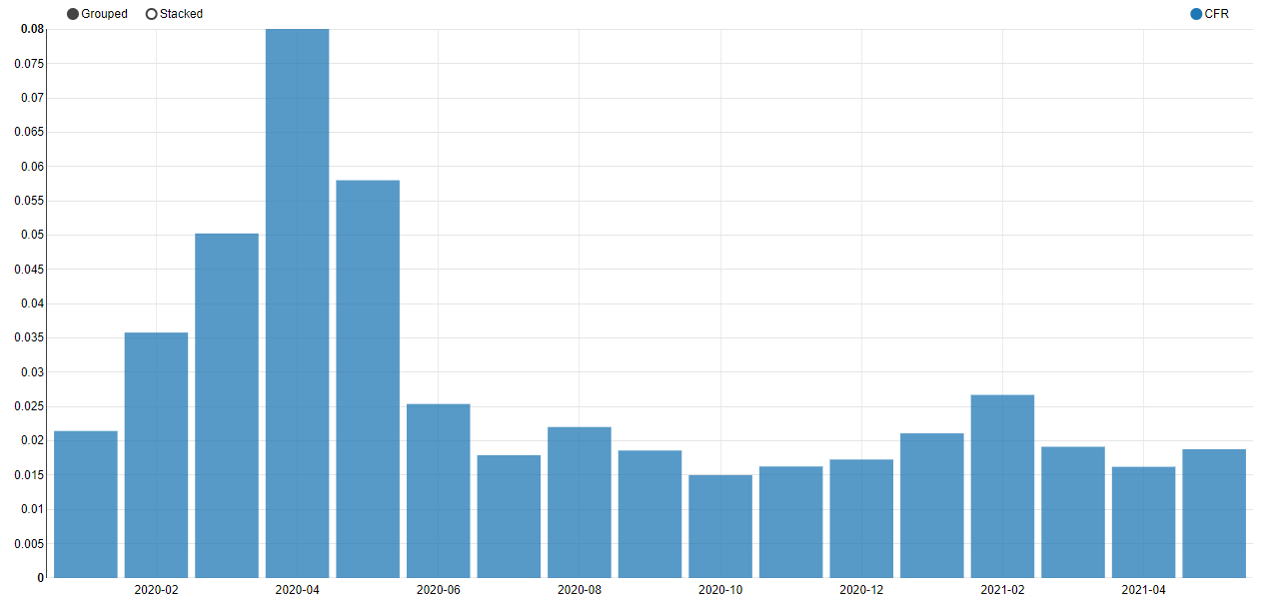
CFR Over Time
8%
1.5%
Notes:
Ben will speak

Slide 39
CFR Over Time
8%
1.5%
Notes:
Ben will speak

Slide 40
Monthly New Cases
Monthly New Deaths
Monthly CFR
Notes:
Ben will speak

Slide 41
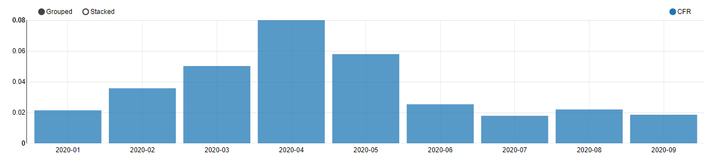
CFR Over Time (Jan. 2020 - Sept. 2020)
Notes:
Ben will speak

Slide 42
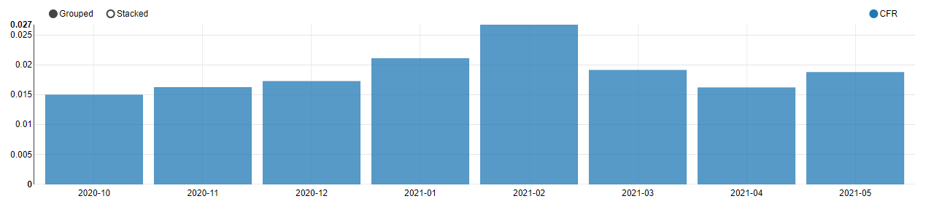
CFR Over Time (Oct. 2020 - May 2021)
Notes:
Tiffany

Slide 43
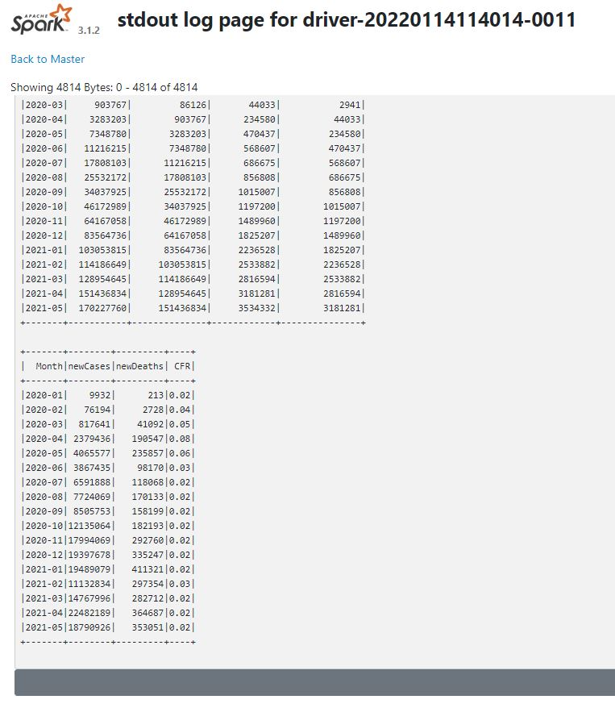
Case Fatality OverTime Worldwide SparkSubmit
Notes:
Brady will speak

Slide 44
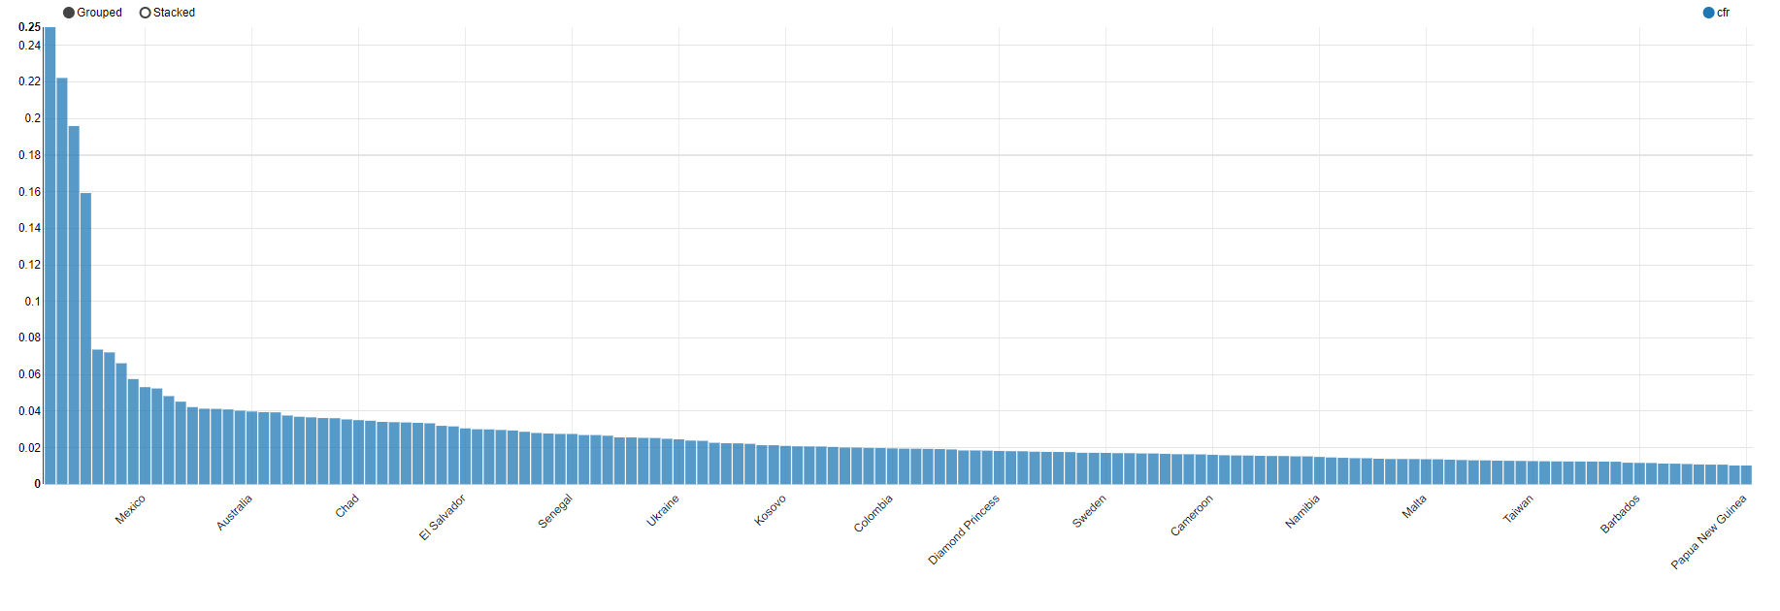
Cumulative CFR as of May 2021 by Country
Notes:
Tiffany

Slide 45
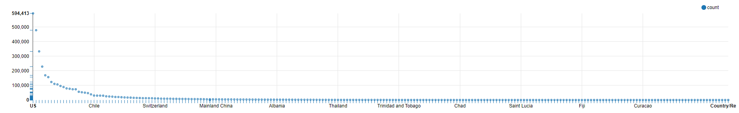
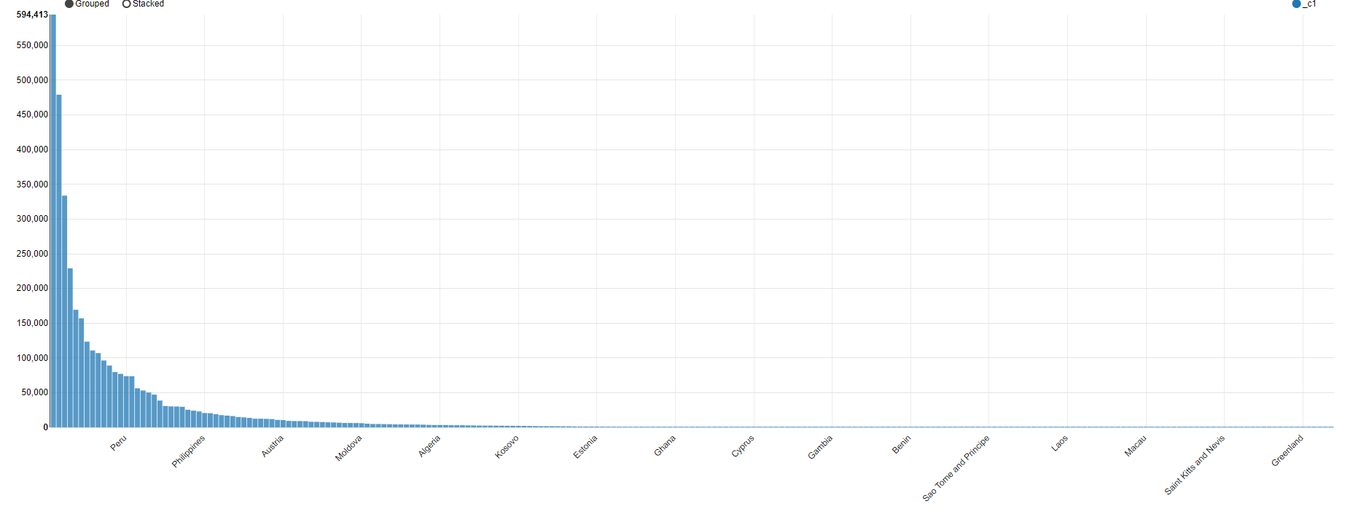
Country case count

Slide 46
Questions/Demo
Notes:
Brian will speak

Slide 47
Important Pandemic Dates

Slide 48
Questions
How is the coronavirus affected by temperature changes?
CDC says that coronavirus dies at 150 degrees Fahrenheit.
https://www.cdc.gov/coronavirus/2019-ncov/community/ventilation.html#:~:text=Research%20on%20the%20impact%20of,damage%20some%20building%20materials.
Why does April (2020 & 2021) seem to be the worst month? (Possibly due to season? (Spr./Fall vs. Sum./Wint.???))
Return to school
Appearance of Delta variant in Apr./May 2021

Slide 49
WHO label | Date of designation | Earliest documented samples
SARS-CoV-2 | 12/1/19 | China
Alpha | 12/18/20 | United Kingdom | Sep-2020
Beta | 12/18/20 | South Africa | May-2020
Gamma | 01/11/21 | Brazil | Nov-2020
Delta | VOI: 4-Apr-2021 VOC: 11-May-2021 | India | Oct-2020
Omicron* | VUM: 24-Nov-2021 VOC: 26-Nov-2021 | Multiple countries | Nov-2021

Slide 51
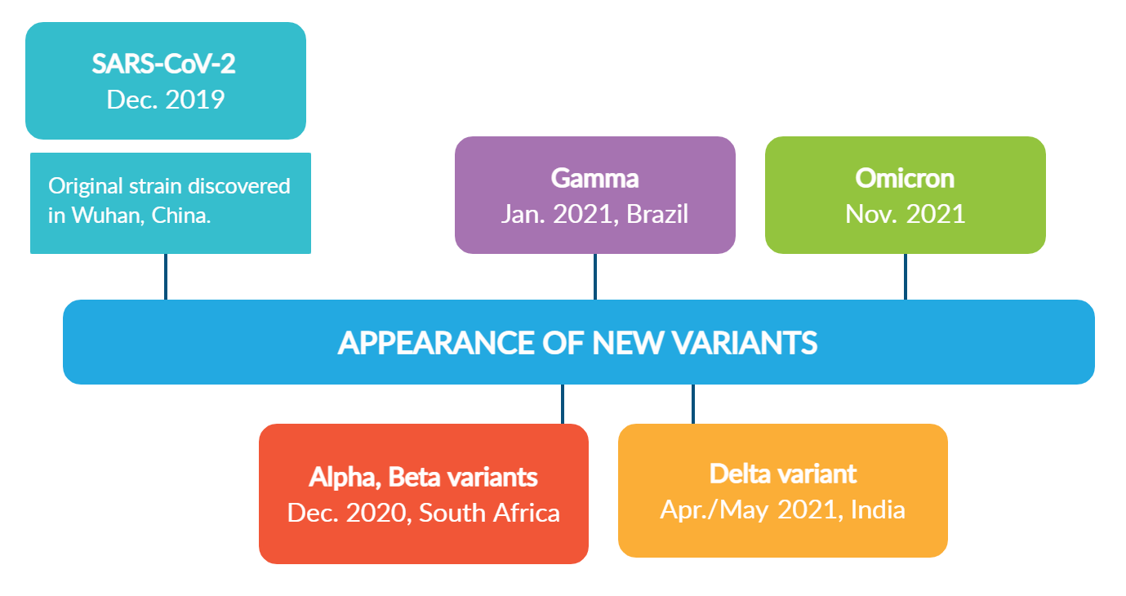

Slide 54
